Slide 1

INVESTMENT ADVISOR
PRESENTED BY :
SONU KUMAR
RAMSHA SIDDIQUI AVANISH YADAV MAHESH DETHE
CO-ORDINATOR AMAN VATS
10/09/2021

Slide 2
CONTENTS
INTRODUCTION
DATASET
VARIABLES
OBJECTIVES
INSIGHTS
CONCLUSION
REFERENCE

Slide 3
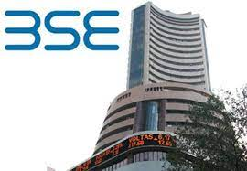
INTRODUCTION
This Project is based on Real-time data from the Indian Stock Exchange named BSE along with other financial ratios where one can view the Performance and Analyze the company.

Slide 4
DATASET
BSE500
Income & Expenses
This data contains 500 companies listed in
Indian Stock Exchange named BSE.
This data contains the income and expense details of an individual.

Slide 5
VARIABLES
Market Capitalization - What a company is worth on the open market.
Enterprise Value - enterprise value (EV) is the total value of a company, defined in terms of its financing.
Returns - Percentage return after investing.
Earnings Per Share - It indicates how much money a company makes for each share.
Dividend Per Share - Dividend per share (DPS) is the sum of declared dividends issued by a company for every ordinary share outstanding.
Cash Flow Per Share - Cash flow per share is the after-tax earnings plus depreciation on a per-share basis that functions as a measure of a firm's financial strength.
EV / EBITDA – a popular metric used as a valuation tool to compare the value of a company, debt included, to the company's cash earnings less non-cash expenses.

Slide 6
OBJECTIVES
To Keep Funds Safe & Secure.
To Grow Your Funds Exponentially.
To Earn an Additional Source of Income.
Minimize Income Tax Burden.
Retirement Planning.
Meet Financial Goals.

Slide 7
INSIGHTS
Top 5 Low-Risk Taking Companies:
Page Industries Ltd.
Abbott India Ltd.
MRF Ltd.
Bajaj Holdings & Investment Ltd.
Honeywell Automation India Ltd.
Top 5 Risk-Taking Companies:
The Great Eastern Shipping Company Ltd.
Welspun Corp Ltd.
Jyothy Labs Ltd.
Gujarat State Fertilizers & Chemicals Ltd.
NCC Ltd.
Top 5 Moderate-Risk Taking Companies:
Cyient Ltd.
Chambal Fertilisers & Chemicals Ltd.
Redington India Ltd.
BASF India Ltd.
Zydus Wellness Ltd.
Top 5 High-Risk Taking Companies:
MOIL Ltd.
Responsive Industries Ltd.
Vakrangee Ltd.
Hathway Cable & Datacom Ltd.
Strides Pharma Science Ltd.

Slide 8
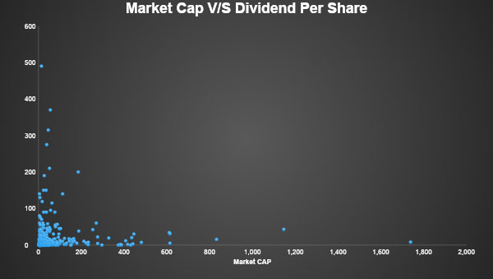
Most of the companies have a Market Cap of less than 2 lakh crores and have dividend Per Share of less than 100.

Slide 9
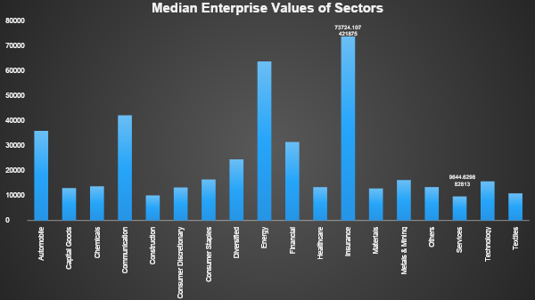
The Insurance sector and the finance sector have greater enterprise value(median) than any other sectors.

Slide 10
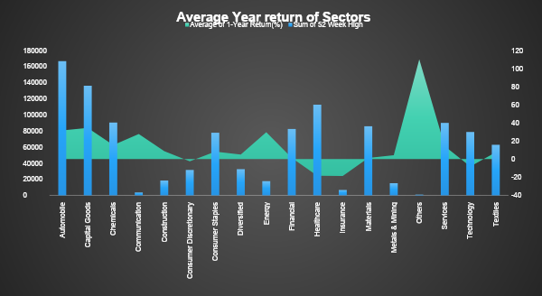
Excluding other sectors Capital Goods, Automobile & Energy has maximum 1 year Return Percentage.

Slide 11
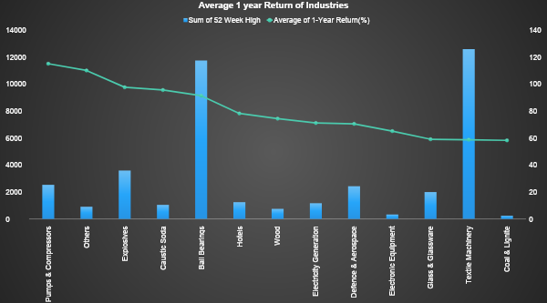

Slide 12
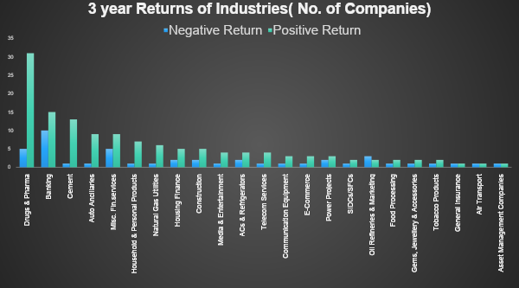
It tells which Industry will be better suited for investment.

Slide 13
CONCLUSION
Sanofi India Ltd. has the highest Dividend Per Share i.e. 470.
Most of the companies have a Market Cap of less than 2 lakh Cr and have dividend per share of less than 100.
Average 1 Year Returns of Energy & Communication Sectors are more than any other Sector.
The average 1 Year Return of the Pumps & Compression Industry is greater than the other Industries and Textile Industry was at the top for High Stock.
Drugs & Pharma Industries have more companies that can give
3-Year Return Positive.

Slide 14
REFERENCES
Financial Terminology – Investopedia
Gspread Library – Gspread documentation
Project Link:-
Investment Advisor

Slide 15
QUESTIONS?

Slide 16
THANK YOU !!!

